Slide 1
Comparison of Transmission Losses of an acoustic channel model for direct and multipath models in Deep water

Slide 2
Overview
Introduction
Literature Review
Methodology
Simulation Parameters
Simulation Results
Conclusion
References

Slide 3
Introduction
UWSN is self-organizing network
a loose collection of independent mobile nodes deployed underwater
with arbitrary topology (Due to Mobility Flexible Network)
communicates through acoustic, optical links and EM
single-hop/multi-hop communication
Preferred acoustics ( speed, power loss, antenna size, range of propagation etc.)
Influenced by (Absorption, Geometric expansion, Doppler spread, Scattering, Multipath, Underwater Environment (depth, temperature, salinity, pH))

Slide 4
Literature Review
The literature available from last three decades, extensively described the research challenges of UWSNs due to its unpredictable environmental conditions.
Numerous authors [1-15] have worked on the basic fundamentals of UWSNs; deployment strategies; connectivity issues; architectural issues; routing protocols; energy; throughput; security; clustering; localization algorithms; and channel modeling etc.
Even though, the research is predominant in UWSNs from last two decades, but the research directions are still open for researches in the areas of security, localization, reliability aspects due to their physical and networking constraints.

Slide 5
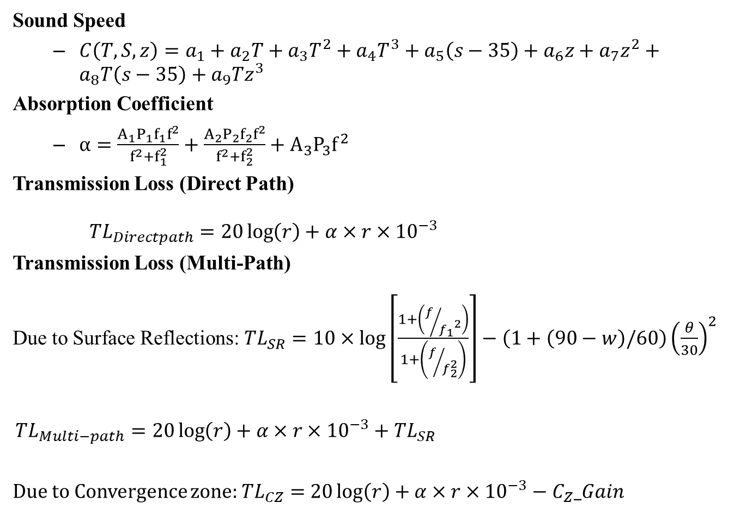
Methodology
Sound Speed
$C\left(T,S,z\right)=a_{1}+a_{2}T+a_{3}T^{2}+a_{4}T^{3}+a_{5}\left(s−35\right)+a_{6}z+a_{7}z^{2}+a_{8}T\left(s−35\right)+a_{9}Tz^{3}$
Absorption Coefficient
$α=\frac{A_{1}P_{1}f_{1}f^{2}}{f^{2}+f_{1}^{2}}+\frac{A_{2}P_{2}f_{2}f^{2}}{f^{2}+f_{2}^{2}}+A_{3}P_{3}f^{2}$
Transmission Loss (Direct Path)
${TL}_{Directpath}=20\log\left(r\right)+α×r×{10}^{−3}$
Transmission Loss (Multi-Path)
Due to Surface Reflections: ${TL}_{SR}=10×\log\left[\frac{1+\left(f/{{f_{1}}^{2}}\right)}{1+\left(f/{f_{2}^{2}}\right)}\right]−\left(1+\left(90−w\right)/60\right){\left(\frac{θ}{30}\right)}^{2}$
${TL}_{Multi−path}=20\log\left(r\right)+α×r×{10}^{−3}+$ ${TL}_{SR}$
Due to Convergence zone: ${TL}_{CZ}=$ $20\log\left(r\right)+α×r×{10}^{−3}−C_{Z}_Gain$

Slide 6
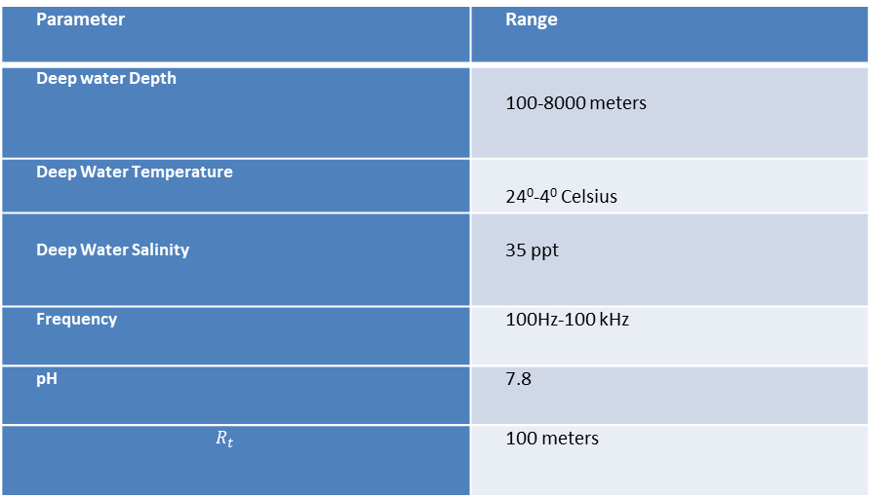
Simulation Parameters
Parameter | Range
Deep water Depth | 100-8000 meters
Deep Water Temperature | 24⁰-4⁰ Celsius
Deep Water Salinity | 35 ppt
Frequency | 100Hz-100 kHz
pH | 7.8
$$R_{t}$$ | 100 meters

Slide 7
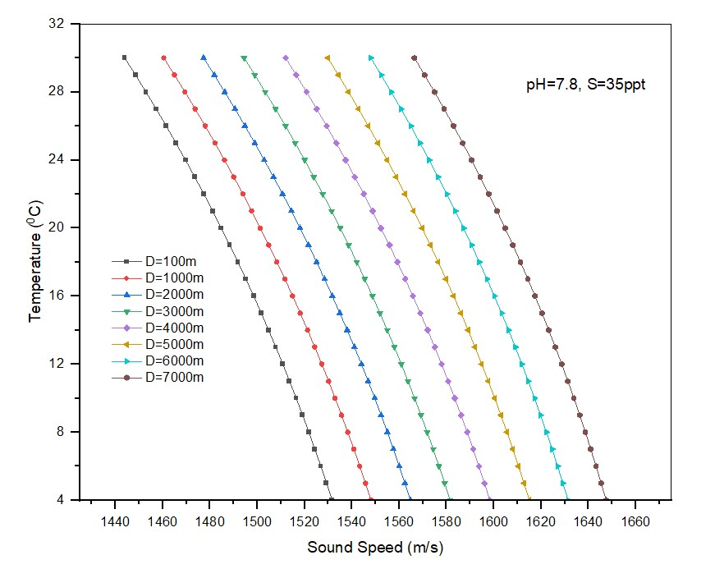
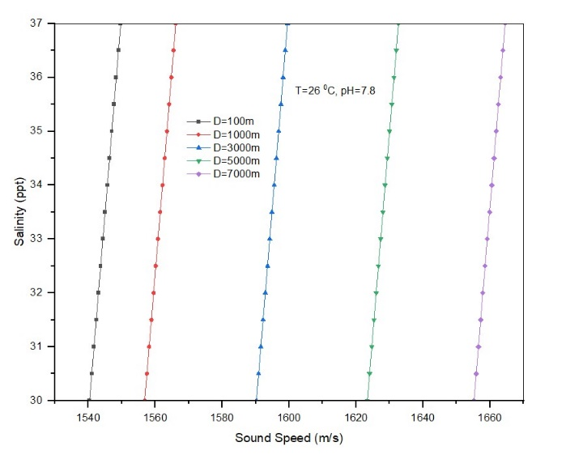
Simulation Results
Effect of salinity and Temperature variations on sound speed in deep-water

Slide 8
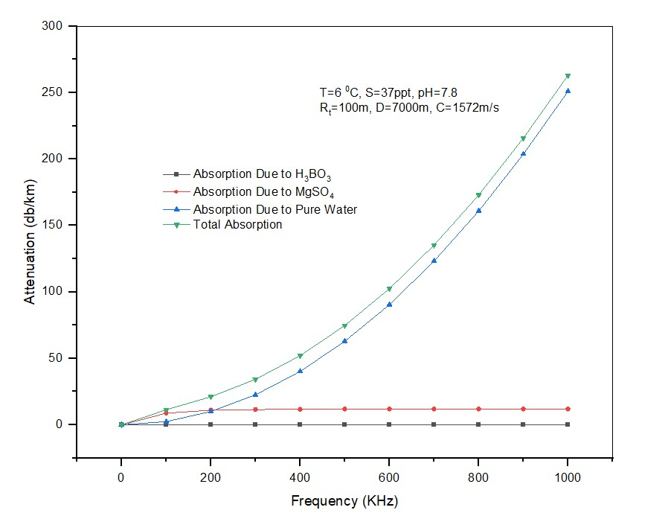
Contd..
Attenuation in deep water due to absorption

Slide 9
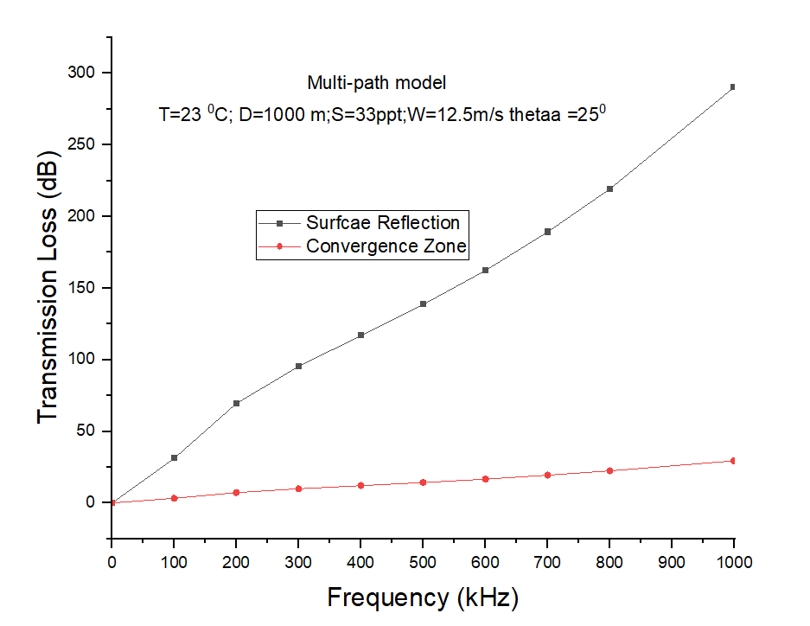
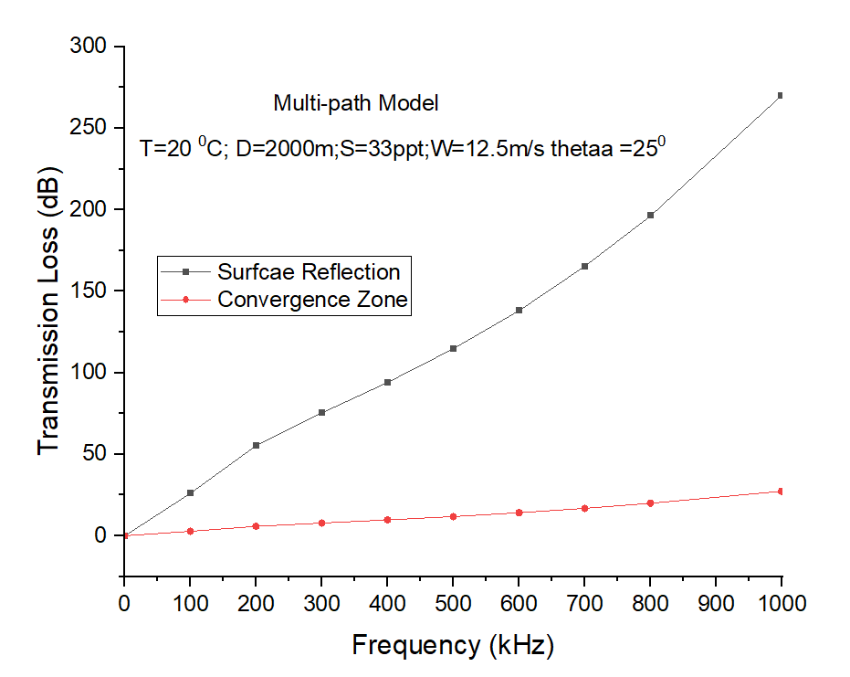
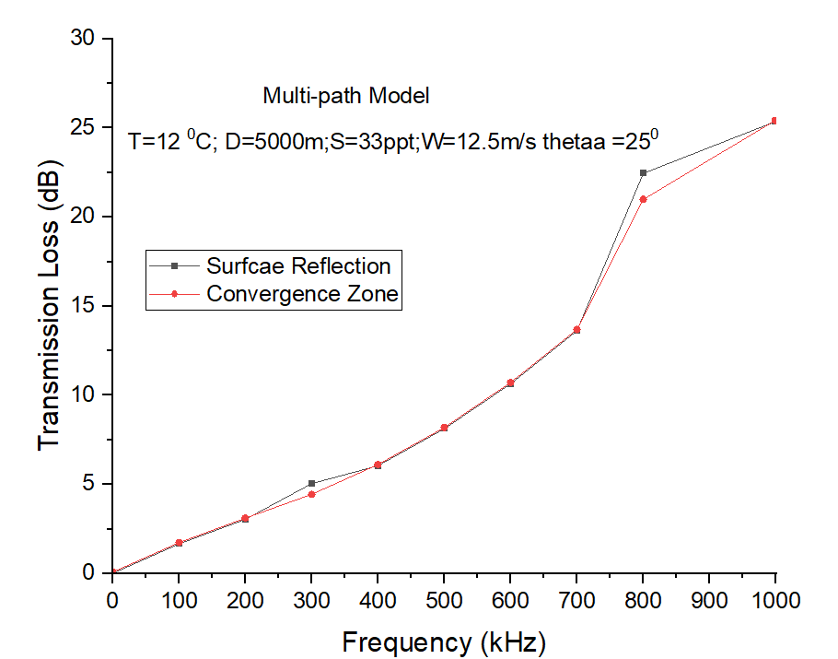
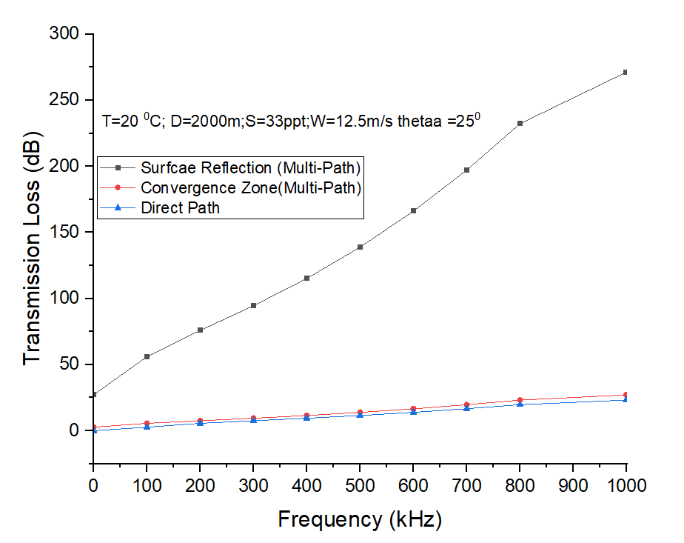
Contd…

Slide 10
Conclusion
It is observed from Simulation results; the transmission losses are frequency dependent
The sound speed increases with depth and salinity in deep water.
The losses due to surface reflection is more when compared to convergence zone.
But at deep water, (5000m) the losses due surface reflection and convergence zone are almost equal.

Slide 11
References
Garcia, M., Sendra, S., Atenas, M., & Lloret, J, Underwater wireless ad-hoc networks: A survey, Mobile ad hoc networks: Current status and future trends, pp. 379-411, 2011.
J. Hidemann, M. Stojanovic, M. Zorzi, Underwater sensor networks: applications, advances, and challenges, Philosophical Transactions of the Royal Society, 370(1958), pp. 158-175, 2012.
N. Farr, A. Bowen, J. Ware, C. Pontbriand and M. Tivey, An integrated, underwater optical /acoustic communications system, IEEE OCEANS Conference , pp. 1-6, 2010.
U. M. Cella, R. Johnstone, N. Shuley, Electromagnetic wave wireless communication in shallow water coastal environment: theoretical analysis and experimental results, In Proceedings of. 4th ACM International. Workshop on Underwater Networks, pp. 1-9, 2009.
E. M. Sozer, M. Stojanovic, and J. G. Proakis, Underwater Acoustic Networks, IEEE Journal of Ocean Engineering, 25(1), pp.72-83, 2000.
F. Akyildiz, D. Pompili, T. Melodia, Underwater acoustic sensor networks: Research Challenges, Ad Hoc Networks, 3(3), pp. 257-279, 2005.
Z. Jiang, Underwater Acoustic Networks – Issues and Solutions, International Journal of Intelligent Control and Systems, 13(3), pp.152-161, 2008.
E. Felemba Shaikh, F.K. Qureshi, U.M.; Sheikh, A.A.; Qaisar, S.B. Underwater sensor network applications: a comprehensive Survey, International Journal of Distributed Sensor Networks, 11(11), pp. 1-14, 2015.
I.F. Akyildiz, W. Su, Y. Sankarasubramaniam, E. Cayirci, Wireless sensor networks: a survey, Computer Networks, 38(4), pp.393-422, 2002.
J. Preisig, Acoustic propagation considerations for underwater acoustic communications network development, Mobile Computing and Communications Review, 11(4), pp. 2-10, 2006.
Milica Stojanovic, On the Relationship between Capacity and Distance in an Underwater Acoustic Communication Channel, Proceedings of the 1st ACM international workshop on Underwater networks, pp. 41-47, 2006.
S Anandalatchoumy, G Sivaradje, Comprehensive Study Of Acoustic Channel Models For Underwater Wireless Communication Networks, International Journal on Cybernetics & Informatics, 4(2), pp. 227-240, 2015.
M.J. Buckingham, Ocean-acoustic propagation models, Journal of Acoustique, 3, pp. 223-287, 1992.
J. Llor, M. P. Malumbres, Statistical Modeling of Large-Scale Signal Path Loss in Underwater Acoustic Networks, Sensors, 13, pp. 2279-2294, 2013.
J. Llor, E. Torres, P. Garrido, M. P. Malumbres, Analyzing the Behavior of Acoustic Link Models in Underwater Wireless Sensor Networks, Proceedings of the 4th ACM workshop on Performance monitoring and measurement of heterogeneous wireless and wired networks, PP.9-16, 2009.
Z. Zhou, Z. Peng, J. H. Cui and Z. Shi, Efficient Multipath Communication for Time-Critical Applications in Underwater Acoustic Sensor Networks, IEEE/ACM Transactions on Networking, vol. 19, no. 1, pp. 28-41, Feb. 2011.
A. Nimbalkar and D. Pompili, Reliability in Underwater Inter-Vehicle Communications, Proceedings of the ACM International workshop, 2008.
Hong Min, Yookun Cho and Junyoung Heo, Enhancing the Reliability of Head Nodes in Underwater Sensor Networks, Sensors, 12, pp.1194-1210, 2012.
C. V. Rao, N. Padmavathy, and S. K. Chaturvedi, Reliability evaluation of mobile ad hoc networks: with and without interference, IEEE 7th International Advance Computing Conference, pp. 233-238, 2017.
N. Padmavathy, Sanjay K. Chaturvedi, Evaluation of Mobile Ad Hoc Network Reliability Using Propagation-based Link Reliability Model, Reliability Engineering and System Safety, 115, PP.1-9, 2013.

Slide 12
THANK YOU
Notes:
QUESTIONS?

